Slide 1
MODULE 9
Managing Transition
Organisational
Culture & Change

Slide 2
ORGANIZATIONAL CULTURE
* Organisational culture is the beliefs and values which are understood by employees.
* Culture is the expression of organisational
experience which personalises the meaning of the organisation for its members.
* Organisations use training and development, performance appraisal and orientation programs to transmit values.

Slide 3



MODULE 9
ORGANIZATIONAL CULTURE
  Culture is a way of life.
      Culture is stable over time
      Culture is resistant to quick change
      Once a culture is well developed, it can resist change despite turnover, changes in product line or any strategic change.

Slide 4
MODULE 9
ORGANIZATIONAL CULTURE
  Culture can develop in a random fashion or it can be managed if a firm has a strategic plan that suggests specific properties for its culture.
  Culture is known by employees and they can
      Describe its characteristics
      Cultures can be evaluated
      Culture can be perfected

Slide 5
MODULE 9
ORGANIZATIONAL CULTURE
  Merger can be a good example of a culture clash that may result in a high turn over (e.g. level of risk taking)
  Dramatic changes in the external environment may lead to organization culture crisis: change in technology, goals and strategies, economy, politics, demography, legislation…etc

Slide 6
ORGANIZATIONAL CULTURE
Organisational culture is reflected in the quality of the employment relationship.
Culture has external and internal aspects.
Large firms have multiple cultures and management must integrate them.
A good culture integrates various subunits and occupational cultures and have solid methods for managing conflicts.

Slide 7
Multiple Cultures in Organisations
* Organisations develop subcultures which reflect variations among subunits.
* Organisational culture is reflected in the specific, professional orientations and skills of groups of employees.
* If these professionals acquire their work values and beliefs through their educational training, then they are bound to exert an effect on their employers’ organisational culture.

Slide 8
Strong Culture
Some strong cultures threaten organisational goal attainment because the cultures legitimise infighting, secrecy and empire building.
A good organisational culture must fit the organisation’s strategic and financial goals.
The main feature of any good culture should be adaptability.
Strong cultures may not mix well in mergers & acquisitions.

Slide 9
Culture Weakness
Reasons for culture weakness include:
1) Poor fit of incoming employees’ personal values.
2) Poor training of new employees in the core aspects.
3) Reward and performance appraisal systems
do not make performance behaviours explicit.
4) Reward systems are not merit based.
5) Top managers are poor role models and mentors
6) Emphasises on failure as much as success

Slide 10
Internal Aspects of Org. Culture
4. Encourage
Innovation
And team
work
1. Product quality
2. Cost effectiveness
3. Minimize
Production
error

Slide 11
External Aspects of Org. Culture
4. Promote
Customer
service
Social
responsibility
2. Timely
distribution
3. Price
competition

Slide 12
Factors Affecting the Culture Development
1- The Chief Executive or Founder
* An organisation’s culture depends heavily on the role of the chief executive or founder.
* Many successful companies owe a lot to their founders or charismatic leaders.
* Strong cultures of some successful companies reflect the personal values of the founder.

Slide 13
2- Socialisation
Socialisation transmits an organisation’s culture from one generation of employees to the next.
Haphazard employee selection
Unchallenging job assignments
Fragmented employee development processes
erode the culture and cause the company to drift from core organisational goals and strategy.

Slide 14
Pascale’s Socialization Process in Supporting Organization Culture
1- Realistic Job Previews:
Descriptions of the characteristics of jobs are used to communicate the company’s expectations for new employees.
2- Debasement and Indoctrination:
are used to create humility in new employees so that they are open to norms about performance excellence.
3- Employees are given intensive on the job training:
so that they master the core areas of the business.

Slide 15
Pascale’s Socialization Process in Supporting Organization Culture
4- Reward and Promotion System Adjustment :
to define performance excellence in the core areas of the business.
5- Base rewards on merit
6- Use managers as personal role models for the culture.
To run meetings, open door policies & reward entrepreneurs.
7- Reinforce the culture with stories about the organisation and its founder.
8- Use mentors to develop younger employees who exhibit personal characteristics consistent with the organisation’s culture.

Slide 16
Socialisation
Top management Should:
1) View the employment relationship as a core aspect of the business
2) Embrace their role of mentors for excellence
3) Be comfortable with the more personal or human aspects of running a business
4) Be open to information from customers and other externals about ways to improve the business.

Slide 17
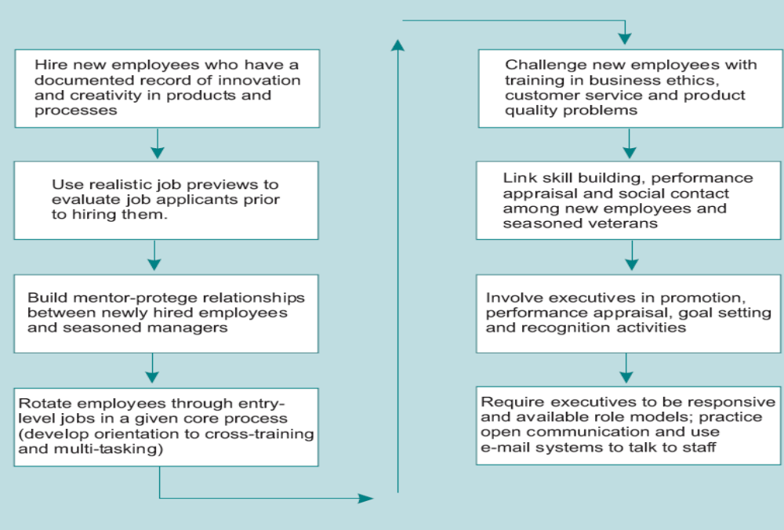
Building a Strong Performance-Oriented Culture

Slide 18
Company Commitment to a Strong Culture Questionnaire
Can you state the company mission?
Do your co-workers display commitment to the Mission
Do employees place company’s goals ahead of personal interests
Are you personally committed to the company’s mission
Can employee describe the company’s areas of competence?
Are employees committed to high standards of performance ?
Does the company reward employees who excel in the business?
Do customers & competitors value your company’s commitment to top product quality and service excellence?
Are employees screened to ensure a match with the company?
Do senior executives act as mentors to young employees?

Slide 19
Developing High-Performance Organisational Cultures
A strong culture is not always a good thing in a company.
A strong, change resistant culture may retard growth, earnings and competitiveness.
The qualities of a company’s culture are much more important than its strength.

Slide 20
Developing High-Performance Organisational Cultures
Good Company Culture should:
Support the sources of financial strength
(e.g. key financial performance goals)
2) Fit the company’s strategic goals
(e.g. market position, industry rank and product rankings)
3) Help the company to adapt its core competencies to market conditions.

Slide 21
Developing High-Performance Organisational Cultures
1 -Job Design.
The work performed can be modified to satisfy the employee needs. Jobs should provide variety, autonomy and l interaction.
2 -People.
Improve the quality of service & speeds up decision making by developing a program of employee empowerment based on the use of self directed teams.
Significant expenditures are made in training .
3 - Control Systems.
Alter performance appraisal and reward systems to encourage new behaviours with employees receiving rewards which they value.

Slide 22
Developing High-Performance Organisational Cultures
1 - The Culture should reinforce long term Fin. performance.
A good culture forges powerful bonds with workforce, company financial performance (ROI, ), company controls and structure.
2- The Company’s Culture must Align with Strategic Goals.
If a company pursues the low cost producer strategy, its culture must support principles of lean staffing, few management layers, decentralised decision making.
3- The Adaptation Aspect of Culture
Emphasises flexibility and encourages the workforce to adapt to the firm’s financial and market strategies

Slide 23
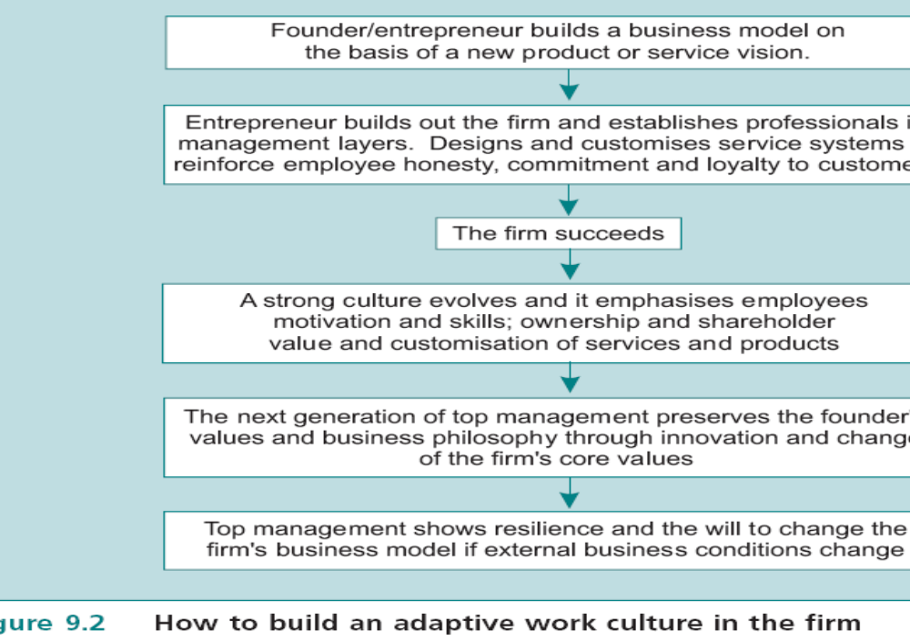

Slide 24
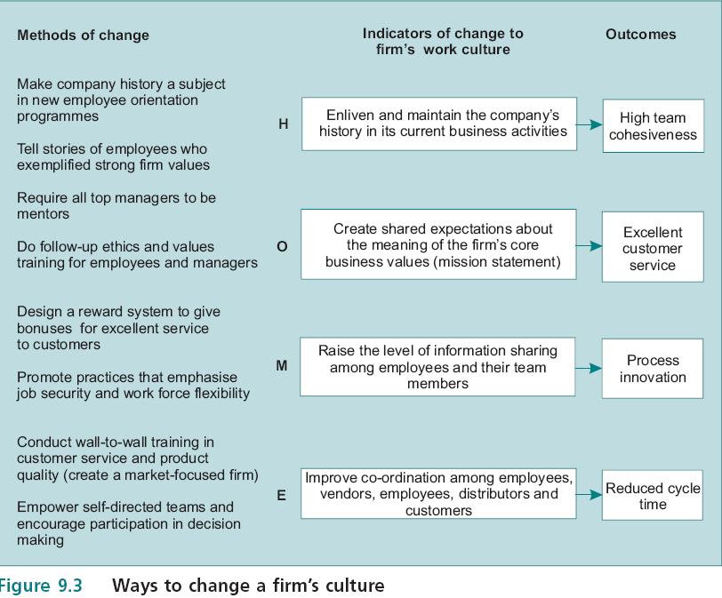

Slide 25
Organizational Life-Cycle Theory
Product Development
Cost-
reduction
Sales/ Services
Quality
Quantity
Start
Growth
Maturity
Decline
TIME

Slide 26
The Organistionsal Life Cycle Model
The lifecycle model covers inception, growth, maturity and organisational decline.
Managers can detect and delay the symptoms of organisational decline.

Slide 27
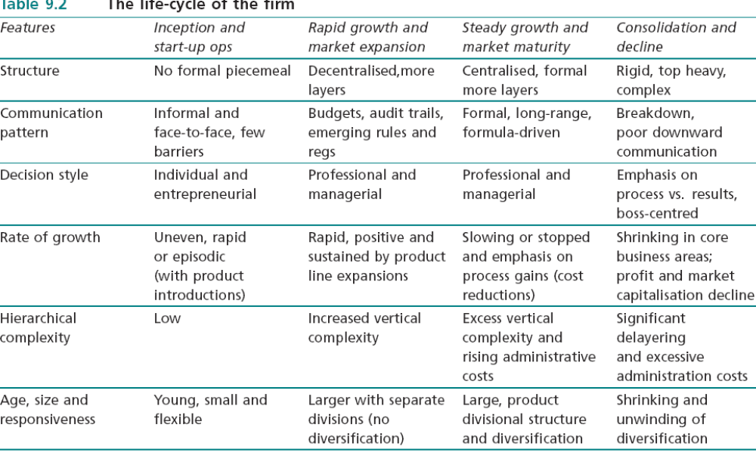
The Life-Cycle Of Firms

Slide 28
Organisational Decline Indicators
Managers who are alert to organisational decline should watch for changes in these 14 factors:
1- Excess personnel.
2 - Tolerance of incompetence
(failure to dismiss poorly performing employees).
3 – Routine administrative procedures.
4 - Powerful staff overwhelm decision makers

Slide 29
Organisational Decline Indicators
5 - Form over substance, e.g., the planning system and its rules become more important than results of planning.
6 - Few clear goals and criteria for measuring success.
7- Reluctance to tolerate conflict or preferring harmony over disagreement
8 - Loss of effective communication and having centralisation
9 - Outdated organisational structure.

Slide 30
Organisational Decline Indicators
10 - Increased scapegoating by leaders
(a rise in political behaviour ).
11 - Resistance to change.
12 - Low morale.
13 - Special interest groups become more vocal
(resist changes in technology and methods).
14 - Decreased innovation (fewer new products0.

Slide 31
Environmental Uncertainty
Environmental Complexity refers to the number and variability of external elements .
Environmental Change refers to the amount of change which external elements exhibit over time.
When organisations detect environmental change, they alter goals and strategies, technology or structure.
If firms detect a change in their internal environments, they alter job design, select different people and train and develop or alter control systems. e.g appraisal

Slide 32
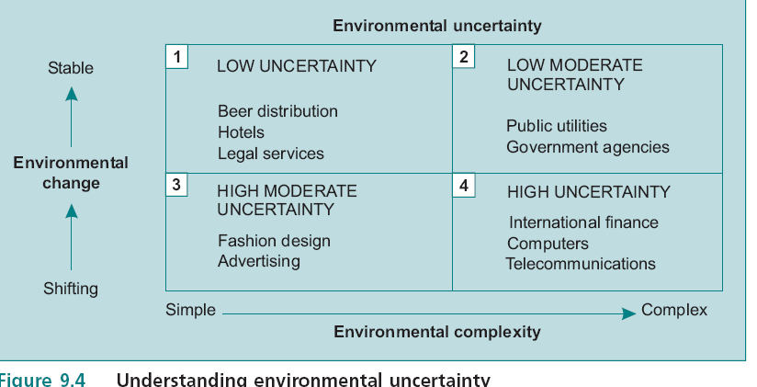
Environmental Uncertainty

Slide 33
Organisational Change
1 - Change goals and strategies.
Organisation may introduce new products or services.
2 - Technology.
The introduction of an email system to facilitate communication is achange in organisational technology.
3 - Structure.
Organisations modify themselves by changing from a functional to a product or territorial design while shifting from centralisation to decentralisation.

Slide 34
Corporate Transition
Beer defines three conditions which must be managed to make a successful corporate transition.
1 - Dissatisfaction with the status quo among employees who must change their behaviour.
2 - The need for a model or vision of the future, which will guide the design of the organisation.
3- The need for a well managed process of change
to help employees modify their attitudes and behaviour.

Slide 35
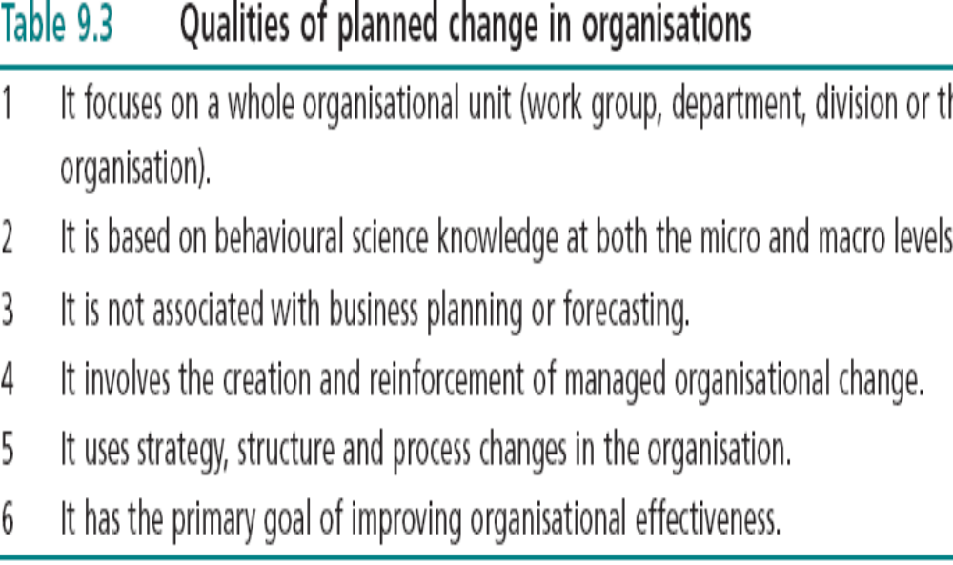
Organisational Change

Slide 36
Unfreezing
Occurs when employees feel dissatisfied with the old culture and processes in the organisation.
Unfreezing represents the ‘constructive destruction’ of ineffective company processes and features.
It may also entail management’s realisation that the company’s work system, training and development system, performance appraisal system or structure do not fit strategy.

Slide 37
Changing
Changing occurs when an action plan is implemented to move the organisation and its members to adopt new behaviours and accept changes to culture.
A planned change can be a restructuring designed to shift the organisation from a centralised functional design to a decentralised service oriented design.
To be successful, the firm must have a model to explain improved organisational functioning, and an employee supported plan for adopting the model

Slide 38
Refreezing
Refreezing occurs when newly developed behaviours, work designs, organisational structures and processes are adopted and become permanent parts of the firm and its culture.
During refreezing, the change process can be examined for its subjective and objective successes.
Refreezing includes the transplanting of successful outcomes of the change process to other firm units and subsidiaries.

Slide 39
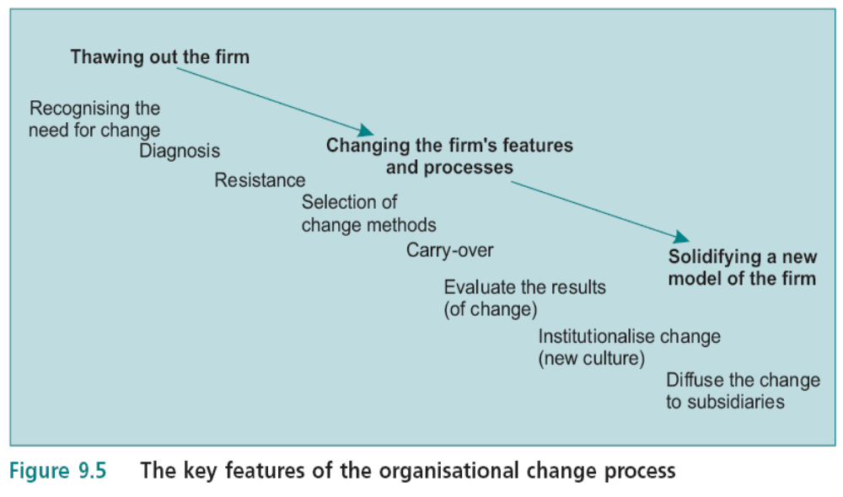
The Key Features of the Organisational Change Process

Slide 40
Diagnosis
Diagnosis is the collaborative process between the organisation and a change agent to bring organisational problems into focus.
Diagnosis is an integral part of the unfreezing process and is usually triggered by an internal or external event which has created uncertainty.
Diagnosis needs not to be reactive.
Some companies use 360degree performance appraisal systems to uncover problems in self directed teams.

Slide 41
Diagnosis
Effective diagnoses are multilevel because it examines individuals and their jobs, functioning , structure, coordination and culture.
A steering committee is composed of members who are high performers, respected and have excellent communication skills.
It reports to upper management.
It is temporary and lasts as long as the program of planned change

Slide 42
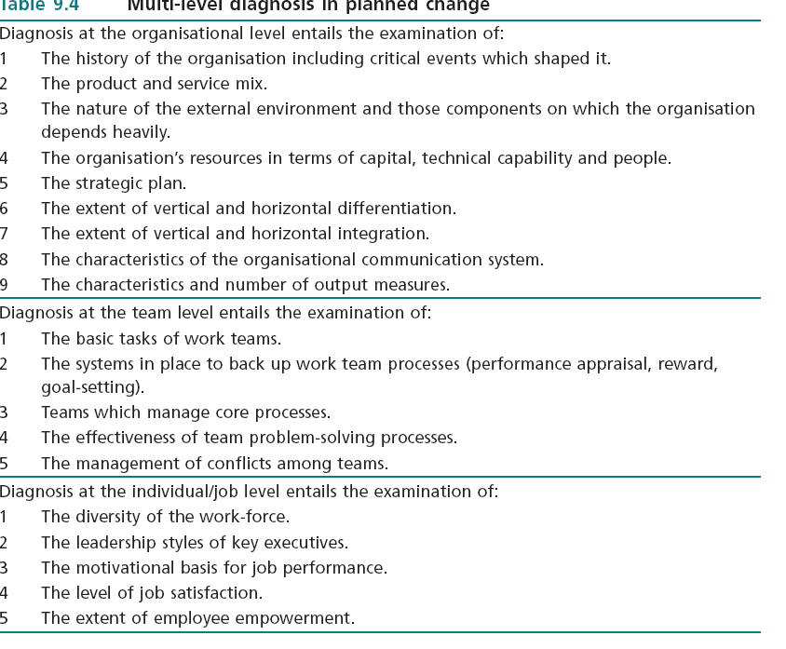
Multi-Level Diagnosis in Planned Change
(Features to be Diagnosed)

Slide 43
Resistance
Resistance happens when employees fear that the personal and organisational costs of change will exceed the benefits and preference for the status quo.
They fear:
1) Economic uncertainty.
2) Loss of personal power.
3) Increased conflict.
4) Changes in work relationships.

Slide 44
Resistance
A change strategy should emphasize the employees ownership for the process
A steering committee should help to make change participative
Examples of employee participation in planned change :
Designing performance appraisal systems
2) Setting up individualised fringe benefits programs
3) Designing cost saving programs which generate group bonuses
4) Employee empowerment programs
5) Total quality management programs
6) Installing self directed work teams.

Slide 45
Resistance
Participation in change programs becomes less important when:
1) Time is crucial or a crisis exists
2) Top management has all the information necessary to make the decision to implement the change
3) The outcomes of the change will have little effect on employees
4) Employee acceptance of the change is not crucial for success
5) Employee skill development is not a significant focus .

Slide 46
Carry-Over
Employees are sent to universities based training programs to learn new management concepts as TQM and self directed teams
The carryover problem in planned change is the erosion of new learning in the work setting when it is not reinforced by managers and workers.
The transfer of new behaviors, knowledge and attitudes to the work setting depends on:
1 - The elements in the change process correspond to specific features of the work environment.
2 - The change is perceived to be immediately useful .
3 - The changed attitudes or behaviours are supported by others in the work environment.

Slide 47
Carry-Over
Creating assignments designed to extend program learning to the work setting.
The assignments involve manager and employees responsible for implementing action plans to bridge the gap between learning and work environment.
Some companies created methods to overcome the carryover problem. Motorola has created Motorola University to conduct all of its employee and executive training in house.

Slide 48
Evaluation
Change programs suffer from poor evaluation.
Programme evaluation should assess:
1) Employee reactions
2) Employee learning
3) Employee behaviour change
4) Organisational outcomes.
• Institutionalisation is making a planned change a permanent part of the organisation’s culture.

Slide 49
Evaluation
The responsibility for designing the measurement tools is on the steering committee.
The organisation benefits from planned change when it develops a ‘profile of programme outcomes’ which measures gains and losses .

Slide 50
Evaluation
Steering committee need to suggest the value of assessing the quality of a planned change process.
Such measurements include
Cost considerations.
the time necessary to meet programme milestones,
Employees’ satisfaction with the nature of the change process
Top management’s judgment of the program’s ease of installation.

Slide 51
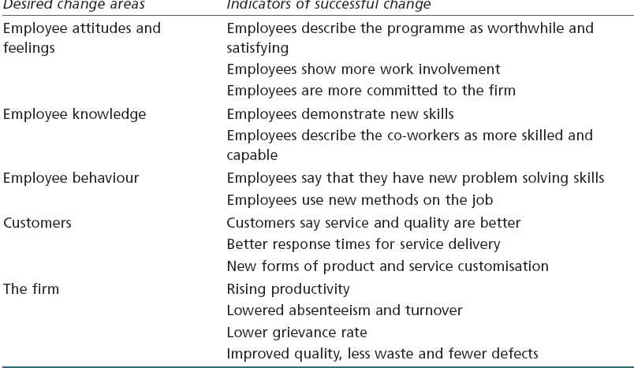
OD Programme Evaluation

Slide 52
Institutionalisation
When planned change achieves institutionalisation, it becomes part of operations in spite of managerial succession, attrition or other alterations.

Slide 53
Institutionalisation
Institutionalisation becomes less likely if:
1 - Formal evaluation of the programme is not conducted.
2 -The change programme is not multilevel
(addresses lower, middle and upper management issues) and multi method
(addresses individual/job characteristics, group process issues and organisational design issues).
3 -The change program takes too long to complete.
4 -The change program does not involve constituencies outside the organisation.

Slide 54
Institutionalisation
5 -Promised rewards are not provided.
6 -The change programme generates employee expectations which cannot be met (e.g., promotion opportunities do not increase).
7 - New members are not exposed to the programme, i.e., it ignores organisational culture.
8 -Key ‘idea champions’ who support the change program leave the firm.
9 -The organisation’s environment changes in some way or profits decline and cause management to abandon institutionalisation.

Slide 55
Diffusion
Diffusion is the orderly transfer of planned change from one organizational unit to another. Diffusion refers to the institutionalization of the change throughout the firm.
It is jeopardized by low commitment to it by top managers, work unit variability, inversion of OD technique and OD goals, unavailability of rewards.

Slide 56
Diffusion
Walton identifies seven factors which can undermine diffusion:
1 Low support and commitment from top management.
Executives give permission for planned change, but they do not become involved personally.
2 The work methods in the focal unit differ from other units, prompting participants to conclude ‘It won’t work here’.
3 The change agent becomes preoccupied with diffusing a particular technique rather than the goals for change which can be adapted to other work units.

Slide 57
Diffusion
4 - No rewards are provided for successfully managing the change programme.
5 - Labor undermines the programme because it believes the program will weaken its hold on employees. (Placing labour reps in the steering committee).
6 - Concern that projects begun in non unionised locations will fail to be implemented by unionised locations.
7- Conflict between the operating characteristics of the work unit undergoing the change and the bureaucratic machinery in the rest of the organisation.
A feature of many successful OD programmes is less bureaucracy.

Slide 58
OD, Organisation Development
OD is an application of behavioural knowledge to the planned development and reinforcement of organisational strategies, structures and processes for improving an organisation’s effectiveness.
Emphasis is placed on interpersonal and group processes
Planned change differentiates OD from random or chaotic events in organisations

Slide 59
OD, Organisation Development
& Change Methods
Change agents are motivated by a set of assumptions :
1 - Employees are growth seeking and they desire self fulfilment.
2 - Employees can assume delegated authority and they try to contribute to organisational goals.
3 - Open and honest communication in organisations is desirable.
4 - Organisations can benefit from improved trust& cooperation.

Slide 60
MODULE 9
CHANGE METHODS IN OD
Change Methods in OD
Interpersonal and
Group (T Group)
B. System-wide
Process change
C. Grid OD

Slide 61
Interpersonal &Group Chang Methods, T-Group Procedure
A facilitator starts the process by stating that the purpose is to help members learn more about themselves and the process which govern the group.
T groups change methods concentrate on the interaction in face to face groups.
It is managed by a change agent (facilitator) to provide members with realistic experiences in interpersonal relations.

Slide 62
A. Interpersonal and Group Change Methods, T-Group Procedure
The group is referred to as an encounter group if the group’s purpose is to help members gain deeper personal knowledge and development.
Encounter groups are uncommon in industrial applications, they are widespread in society: psychotherapy, drug rehabilitation, and support groups ( weight watchers, parents with handicapped children )

Slide 63
Why T-groups Do Not
Work in Firms?
T-group goals do not align with profit-making and other goals:
1 Emphasize personal style and others’ feelings instead of profit and performance
2 Personal awareness is more important than improved work methods
3 Group influence process are changed without consideration of profit making and
performance relationships
4 Member satisfaction and cohesiveness may actually undermine the firm’s performance.

Slide 64
Why T-groups Do Not
Work in Firms?
T-group applications may trigger these problems in profit making firms:
1- Negative, personal feedback among T-group participants may undermine existing work relationships
2- The learning in the T-group environment may not transfer to the work setting
3- T-group applications are perhaps more useful in the limited area of stress management practices

Slide 65
T-groups Success Factors
T-group can improve organisational functioning if four conditions exist:
1) The T-group must be structured and problem focused
so that learning can be transferred back to the work setting.
2) The use of T-groups should be tied to an ongoing OD intervention
3) T-group activities should be confined to the beginning of an intervention (to help unfreeze the organisation)
4) The culture of the organisation must support the use of T-groups.

Slide 66
T-groups & Team Building
The organization's culture must support and encourage conflict confrontation rather than suppression, employee empowerment and information sharing.
Teambuilding has been developed in response to the problem of carryover in T-groups.
It focuses on work groups, project teams or newly created work units which must work together to achieve organisational goals.
A task oriented method emphasises the solving of real organisational problems.

Slide 67
Team-Building
Teambuilding is an excellent tool for ensuring
the fit between culture and mission, goals and strategy (the top three crucial elements in organisational effectiveness).
Managers recognise that teambuilding should be a regular process for diagnosing and attacking problems before threatening the firm integration .

Slide 68
Objectives of Team-Building
1- Developing methods to make decisions and set goals.
2 - Handling conflict between project teams and functional units.
3- Improving relationships between the manager and its members.
4 - Solving product or service quality problems.
5- Clarifying job requirements and work expectations for members.
6- Attacking organisational co-ordination problems.

Slide 69
Typical Steps in a Team-Building Program
1 - Teambuilding Workshop.
Structured group exercises unfreeze attitudes and prepare the groups to accept change.
2 - Data Collection.
Team members fill out a questionnaire to measure culture, leadership styles and facets of job satisfaction.
3 - Data Confrontation.
Change agents present work teams with data. Using group problem solving, the teams develop lists of recommended changes.

Slide 70
Typical Steps in a Team-Building
4 - Action planning:
The teams develop specific plans to bring about the
changes .
5 - Teambuilding:
Barriers to effective work group decision making are isolated and solutions are developed.
6 – Inter group Teambuilding:
Teams with interdependent goals establish collaborative methods to handle them

Slide 71
System-Wide Process Change
Survey feedback
Top management sets up a steering committee to assist a change agent who develops a valid organizational survey and interview procedure.
The survey is pilot-tested on the steering committee and selected employees then distributed to the workforceto gather survey data
3. The change agent analyses the data
4. Results are fed back to the firm: steering committee, top management, managers, self directed employees .
5. Head of work units and employees construct action plan to address problems detected by survey analysis.

Slide 72
System-Wide Process Change
Using the action plans, the change agent and the steering committee present top management with a list of change priorities.
7. The steering committee and change agent work with units to install action plans
8. Program evaluation is conducted to assess change in employee reaction, learning, behaviour and organizational outcomes.

Slide 73
Grid Organisation Development
Grid OD is a comprehensive, long term effort( may take a large organisation several years to complete all six steps) directed at changing the entire organization.
The basic assumption of the method is that company success can be achieved only if there is a simultaneous concern for high performance and the maintenance of a psychologically healthy work environment.
It follows a diagnostic procedure which leads to emphasis on concern for performance and for people

Slide 74
MODULE 9
C. GRID OD
Pre-packaged OD Method
Grid OD follows a six-step procedure
  Grid Seminar: encourage unfreezing, identify managerial style
  Intragroup development: analysis of group decision-making
  Intergroup development: break down communication barrier
  Development of an ideal strategic model by top management
  Attaining the ideal strategic model: closing the gap
  Stabilization and process critique: internal & external evaluators

Slide 75
Grid Organisation Development
1- Grid seminar.
A structured team building activity designed to encourage unfreezing by having participants diagnose their own styles.
2- Intra-group development.
Work teams attend seminars to improve team decision making processes. It includes an analysis of group decision making capabilities and obstacles to effective group decision making.
3- Inter-group development.
Work groups work through a set of structured activities to break down communication barriers.
The emphasis in this phase is on inter-group cooperation.

Slide 76
Grid Organisation Development
4- Development of an ideal strategic model.
Focuses on development of an ideal model by the top managerswhich represents where the organisation would like to be in terms of financial goals, structural design .
5 Attaining the ideal strategic model.
Taskforces are created to develop a plan for closing the gap between the organisation’s current level of functioning and the ideal model developed by top managers.
6 Stabilisation and process critique.
The results of changes are evaluated using quantitative data by internal and external evaluators.

Slide 77
Grid Organisation Development Problems
It may not suit all firms.
Many firms do not finish all six steps because key events can cause managements to suspend Grid work.
Grid OD has many phases and changes which makes it hard to figure out which elements in the various steps have caused favorable outcomes.

Slide 78
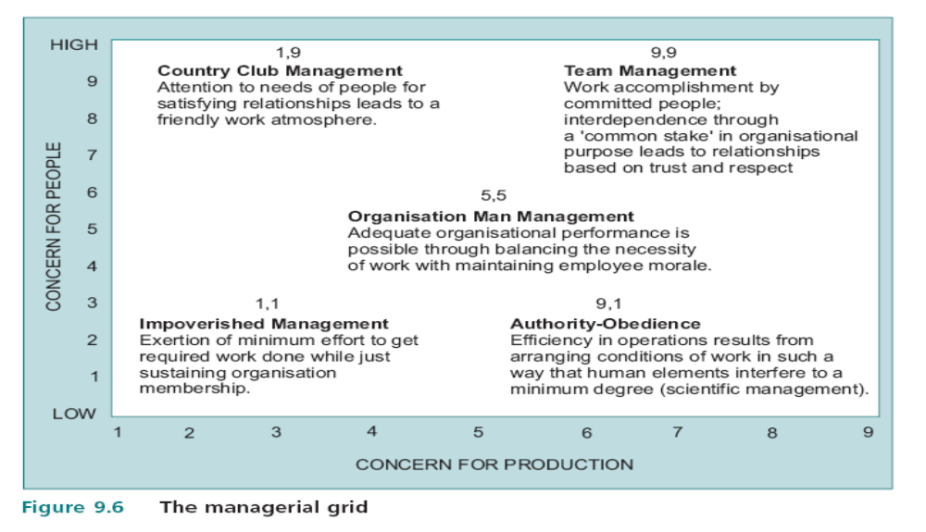
The Managerial Grid

Slide 79
OD Program Success
A successful OD plan depends on matching the method and the depth of the intervention.
No one single method approach of T group, team building ,job enrichment and job design Programs, was successful alone in all instances
Multi method approaches have more positive effects on organisational effectiveness and employees’ need satisfactions than single method programs
Improvements in organisational functioning were obtained when methods were combined.

Slide 80
OD Program Success
A successful combination of interventions should have:
1) All employees participated in goal setting,
decision making and job redesign
2) Employee empowerment was created through self directed teams
3) The company was delayered.

Slide 81
OD Program Success
Effective use of OD techniques requires :
  Accurate diagnosing of problems
  Creating dissatisfaction with the status quo .
  Selecting the proper combination of OD techniques
  Evaluating the outcomes of the program.

